Slide 1
Customer Retention Insights:
Predicting and Preventing Churn

Slide 2
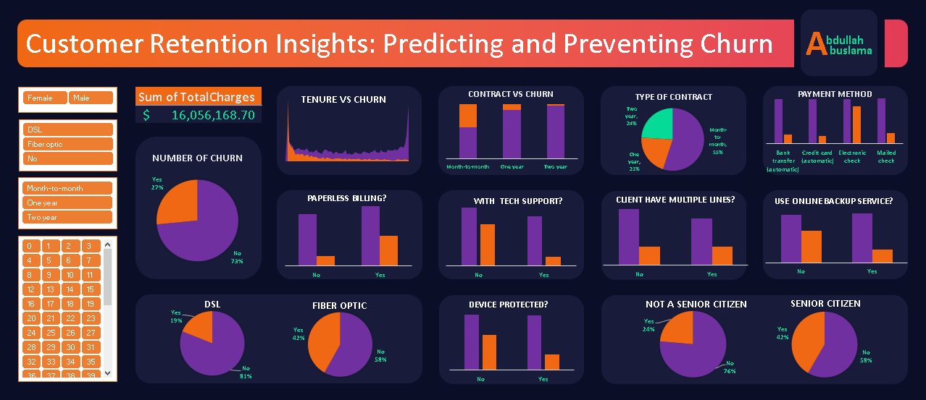

Slide 3
Churn Distribution
Insight: Approximately 27% of the customers have churned, as shown by the pie chart. This indicates that more than a quarter of the customer base has left, which highlights the need for effective retention strategies.

Slide 4
Tenure and Churn
Insight: The "Tenure vs Churn" line chart shows a higher churn rate among customers with shorter tenures. This suggests that newer customers are more likely to leave, emphasizing the importance of improving early customer engagement and satisfaction.

Slide 5
Contract Type and Churn
Insight: Customers with month-to-month contracts have the highest churn rate compared to those with one-year or two-year contracts. Long-term contracts seem to contribute to customer retention, which suggests that offering incentives for longer commitments could be an effective strategy.

Slide 6
Payment Method and Churn
Insight: The bar chart indicates that customers who use electronic checks have a higher churn rate compared to those using other payment methods like bank transfer or credit card. This could mean that customers using electronic checks might be less satisfied or more price-sensitive.

Slide 7
Internet Service and Churn
Insight: Customers using Fiber optic services show a more churn rate (42%) compared to those using DSL (19%). This suggests that Fiber optic users might have an issue with the service, which could be a key selling point for retaining customers.

Slide 8
Tech Support and Churn
Insight: Customers who do not have tech support are more likely to churn. Providing tech support or emphasizing its value could reduce churn, particularly for customers who might face technical challenges.

Slide 9
Paperless Billing and Churn
Insight: Customers who opt for paperless billing appear to have more churn rates. Encouraging more customers to switch to paperless billing could be a problem and not effective step towards retention.
We have to find the issue with the paperless billing.

Slide 10
Senior Citizens and Churn
Insight: Senior citizens make more Churn than the other citizen so maybe we don’t take care of them as it should. So we should consider to find the problem that they have and try to solve it to decrease the churn rate.

Slide 11
Multiple Lines and Churn
Insight: Customers with multiple lines tend to churn more compared with other customers so maybe we have a problem in the service with the multiple lines users we have to take car of this issue.

Slide 12
Total Charges
Insight: The total revenue from the current customer base is significant ($16,056,168.70), indicating the high financial impact of churn. Focusing on retention can help protect this revenue.

Slide 13
Device protected and backup service
Insight: we find that when the customer use the services like device protection and backup service it's more likely to stay in the company, so maybe that indicate that these services is satisfying for the users this maybe indicate that we should focus on these services more to make as possible from the users get these services.

Slide 14
Recommendations:
Focus on Retaining New Customers: Since churn is higher among customers with shorter tenures, consider onboarding programs or early engagement strategies.
Promote Long-term Contracts: Offering incentives for customers to switch to longer contracts might help reduce churn.
Target High-Risk Segments: Customers using electronic checks and those without tech support could be targeted with specific retention campaigns.
Bundle Services: Promote bundles that include multiple lines or value-added services like tech support to enhance customer loyalty.

Slide 15
THANKS!
Do you have any questions?

